Slide 1
Positive Behavioral Intervention Supports
Thomas Jefferson Elementary School

Slide 2
ROAR
Respectful
Organized
Admirable
Responsible

Slide 3
Respectful
Be an active listener
Eyes on speaker
Mouth closed
Use appropriate voice level
Level 0 is silent
Level 1 is a whisper
Level 2 talking to an elbow partner
Respects others
Keep hands and feet to yourself
Using kind words

Slide 4
Responsible
Keeps hands and feet to themselves
Takes responsibility for their behavior

Slide 5
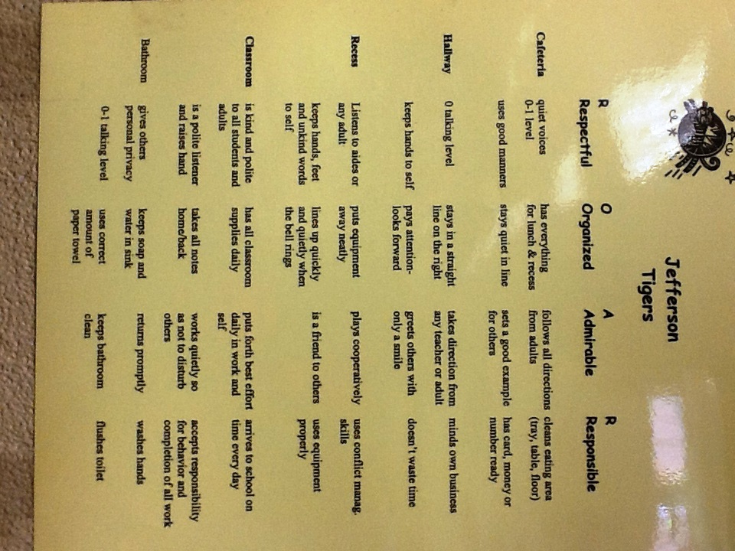
Expectation Matrix

Slide 6
Cafeteria Expectations
Use a voice level of 0 or I
Leaves the area clean after eating
Follow directions first time given
Walk to and from the cafeteria line
Raise your hand and wait for an adult to assist you
Eat the food on your tray

Slide 7
Hallway Expectations
Use a level 0 voice
Keep hands to yourself
Walk in line while keeping personal space
Greet others with a smile
Follow adult directions
Wait for your turn

Slide 8
Recess Expectations
Be Respectful
Voice Level 4
Be kind, assertive and polite
Share the equipment
Keep hands and feet to self
Use equipment appropriately
Be Responsible
Line up when whistle is blown
Stay within the playground area
Report conflicts to recess aides

Slide 9
Bathroom Expectations
Be Respectful
Voice Level 0/1
Take turns
Use bathroom in a timely fashion
Be Responsible
Make sure toilet seats are clean and flushed when done
Report messes immediately
Use the proper amount of soap and paper products
Dispose of paper products properly

Slide 10
Classroom Expectations for Routines and Procedures
Everyday procedures are clearly marked, posted and easy to follow
Classroom management system is posted (including rules, consequences/incentives system)
Clear system for collection and distribution of student work
PBIS expectations are posted

Slide 11
Reinforcements for Good Choices
Tiger Tickets
Verbal Praise
Star Student Recognition
Participate in Wacky Wednesday Wheel
Earn rewards such as: jean day, extra recess, movie day

Slide 12
Examples of Consequences in the Classroom
Redirection
Time Away- Complete reflection sheet
Note home
Phone call home
Parent/teacher conference

Slide 13
Consequences beyond the classroom
Remember to document on the Student Data Sheet behaviors that are to be shared with parents.
Once a student has three classroom referrals place those into Mrs. Eismin’s mailbox along with a log of contacts made to the parent or guardian.
The office will contact the parent and will notify the teacher of the call.
Data should continued to be collected to develop a functional behavior analysis and behavior intervention plan.

Slide 14
Thomas Jefferson Behavior Consequence Rubrics
 | Behavior | 1st incident | 2nd incident (repeated) | 3rd incident (repeated) | 4th incident (repeated) | 5thincident(repeated)
Level 1 Classroom | Chewing gum, off task behavior, inappropriate language | Verbal warning, document | Contact parent, class consequence, document | Contact parent, class consequence, document | Contact parent, class consequence, document | Move to Level 2
Level 2 Classroom | Rudeness or disrespect of staff, Disruptive in class, Not completing required assignments, Leaving without permission, level 2 swearing, unprepared for class, cheating, threats to hit, theft | Contact parent, class consequence, document STI C2.1 | Contact parent, 2nd stage classroom consequence, document STI C2.2 | Contact parent, Sent to office, 1 week no specials Document STI C2.3 | Contact parent, Sent to office, Detention Document STI C2.4 | Documentation used to create behavior plan with teacher, student, parent & school official STI C2.5
Level 2 Classroom Send to office | Repetitive non-compliance | Sent to office, Contact parent, 1 inside recess/lunch Review behavior plan STI O2.1 | Sent to office, Contact parent, 3 inside lunch/recess STI O2.2 | Sent to office, Contact parent, 1 week no specials STI O2.3 | Sent to office, Contact parent, Detention STI O2.4 | Behavior plan revised or developed with teacher, student, parent & school official STI O2.5
Level 2 Office | Hitting, pushing, slapping, grabbing | 1 inside lunch/recess, Contact parent STI O2.1 | 3 inside lunch/recess, Contact parent STI O2.2 | 5 inside lunch/recess, 1 week no specials, Contact parent STI O2.3 | I day ICBM, Contact parent STI O2.4 | Behavior plan revised or developed with teacher, student, parent & school official STI O2.5

Slide 15
 | Behavior | 1st incident | 2nd incident (repeated) | 3rd incident (repeated) | 4th incident (repeated) | 5thincident(repeated)
Level 3 Office | Physical aggression, threats of violence, severe harassment, destroying property | 5 inside lunch/recess, 1 week no specials, Contact parent STI O3.1 | 10 inside lunch/recess, 2 weeks no specials, Contact parent STI O3.2 | 3 days out of school suspension, Contact parent STI O3.3 | Multiple day out of school suspension, Behavior plan developed with teacher, student, parent & admin STI O3.4
Level 4 Office | Severe Behavior (fighting, aggression, weapons, theft) | Administration determines consequences STI O4.1

Slide 16
Resources
http://jeffersonelementarypbis.weebly.com/
Check out our PBIS website for more information

